Slide 1
Opioid Prescription Prediction
Jimmy Smart

Slide 2
Project Outline
Q: Can opioid prescriptions be predicted by features such as location by states or gender of prescribing specialists?
Data Wrangling
Dropping redundant variables
Finding/Dropping null values
Identify opioid drug names
Identifying sum of opioids and non opioids prescribed by specialists
Data Visualization
States
Specialty
Gender
Drugs
Statistical Analysis
Frequentism
Bootstrapping
Bayesian Inference
Model Optimization
Hyperparameter tuning (randomized search, grid search, feature engineering
Random Forests
XGBoost
Ridge/Lasso
Clustering

Slide 3
Introduction
The dataset contains summaries of prescription records for 250 common opioid and non-opioid drugs written by nearly 25,000 unique licensed medical professionals in 2014 in the United States for citizens covered under Class D Medicare as well as some metadata about the doctors themselves. This is only a small subset of data that was sourced from a much larger file: cms.gov.
The original datasets called opioid.csv, overdoses.csv and prescriber-info.csv were loaded in as 3 dataframes into a Jupyter Notebook. Once the data was loaded, the shape of the main dataset (prescriber-info aka prescriber) was confirmed to be 24759 rows by 256 columns. The datasets (opioid and overdoses) were confirmed to be 113 rows × 2 columns and 50 rows × 2 columns respectively.
The goal of this project is to use the features listed above to predict whether an opioid prescription is based of certain specialists and is influenced by their location and/or gender

Slide 4
Data
Wrangling

Slide 5
Redundant variables from prescriber dataset
An initial glance at the dataset revealed certain variables to be redundant and some containing missing values or contain many unique categories, all of which would provide little information during further analysis or during the modeling process. The following variables were excluded from our dataset with the reasoning provided beside each one:
Credentials: provided a set of initials indicative of medical degree. They were deemed redundant due to the more important Specialty variable
Within the State variable we removed certain US territories such as (PR, AA, GU, AE, ZZ) as we just want to focus on the 50 states. DC was merged into VA

Slide 6
Finding any null or missing values
The number of missing values for each feature was determined using the prescriber.isnull().sum() method in Python which provided a list of all the variables along with the number of non-null values in each as well as the data type of each variable providing a good overview of the structure of the dataset. Credentials variable was the only variable with any null returns. Since we are dropping Credentials anyway from our dataset, we can continue on.

Slide 7
Identifying opioid drug names
Now that we have cleaned up our dataframe a bit we can start looking at the data a bit better. We will start by identifying opioids by comparing drug names found in the prescriber dataframe and drug names found in the opioid dataframe. Identifying the opioids will help us with our various comparisons between regularly prescribed drugs and opioids.
List of opioids:
MORPHINE.SULFATE.ER
METHADONE.HCL
HYDROCODONE.ACETAMINOPHEN
ACETAMINOPHEN.CODEINE
HYDROMORPHONE.HCL
MORPHINE.SULFATE
TRAMADOL.HCL
FENTANYL
OXYCODONE.HCL
OXYCODONE.ACETAMINOPHEN
OXYCONTIN

Slide 8
Identifying sum of opioids and non opioids prescribed by specialists
Using the code we just used to identify the opioid drug names, we were able to create a code to find the sum of opioids prescribed by each specialist in our dataset.
prescriber['SumOpi'] = prescriber[opi_presc].sum(axis=1)
As well as the sum total number of prescriptions written by each specialists:
prescriber['TotPresc'] = (prescriber.iloc[:,4:254]).sum(axis=1)
With ‘SumOpi and ‘TotPresc’ we were able to create a 3rd column consisting of the non opioids:
prescriber['NonOpi'] = prescriber['TotPresc'] - prescriber[opi_presc].sum(axis=1)

Slide 9
Data
Visualization

Slide 10
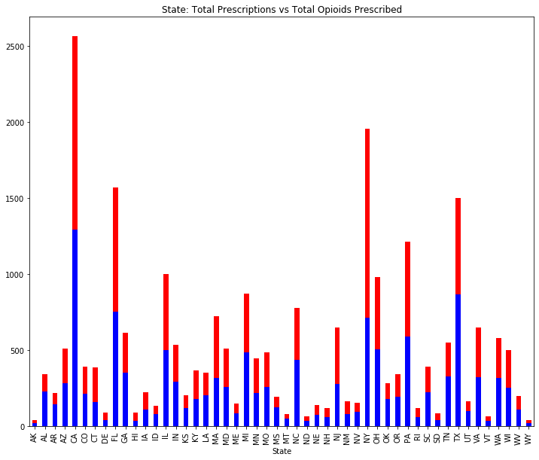
Looking at the data with a focus on the States
Total Prescriptions
Total Opioids

Slide 11
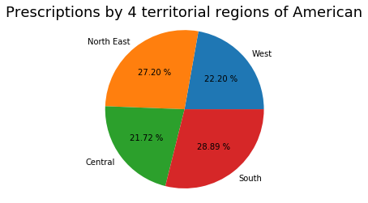
We then grouped the states into 4 geographical categories represented by: North East, Central, South and West. Each region consists of either 12-13 states within their groups. Below shows a pie chart of the breakdown of our results.

Slide 12
Specialties
(value counts)
Hematology/Oncology 214
Physical Medicine and Rehabilitation 195
General Practice 176
Endocrinology 152
Pediatric Medicine 144
Oral Surgery (dentists only) 140
Anesthesiology 138
Rheumatology 130
Allergy/Immunology 119
Infectious Disease 117
Plastic and Reconstructive Surgery 99
Radiation Oncology 87
Medical Oncology 84
Neurosurgery 82
Certified Clinical Nurse Specialist 70
Vascular Surgery 65
Geriatric Medicine 59
Nephrology 233
Psychiatry & Neurology 263
Internal Medicine 3162
Family Practice 2967
Dentist 2771
Nurse Practitioner 2511
Physician Assistant 1838
Emergency Medicine 1081
Psychiatry 686
Cardiology 679
Obstetrics/Gynecology 606
Orthopedic Surgery 572
Optometry 571
Student in an Organized Health Care 545
Ophthalmology 514
General Surgery 484
Gastroenterology 394
Podiatry 367
Neurology 364
Dermatology 343
Urology 328
Pulmonary Disease 262
Otolaryngology 255

Slide 13
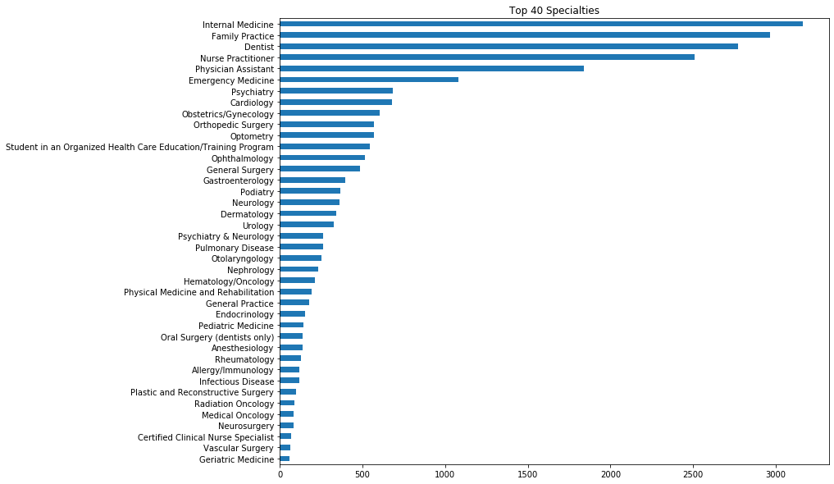
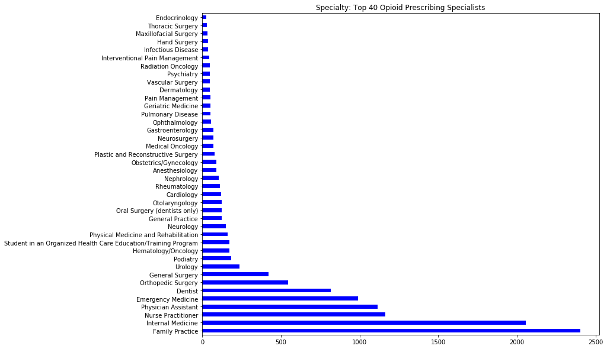
Specialties

Slide 14
Specialties
As we can see in the previous figures, there are some difference between the respective Top 40s of each graph. Internal Medicine, Nurse Practitioner and Family Practice are at or near the top of each figure.
We created a chart for the top 5 specialists who prescribed opioids and their percentages in reference to the rest of the specialties:
Percentage of Prescriptions from the top 5 prescribers
Value Opi Percent Opi
Family Practice 2402 18.93
Internal Medicine 2057 16.21
Nurse Practitioner 1165 9.18
Physician Assistant 1113 8.77
Emergency Medicine 990 7.80

Slide 15
Gender
First and foremost we wanted to see the percentage differences there were present between Males and Female specialists who didn’t prescribe opioids as well as a pie chart of total differences between Males and Females within our dataset. The following image represents a pie chart showing the results.

Slide 16
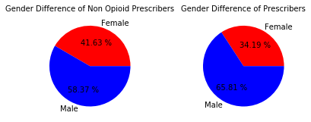
Overall there were 5025 Females who didn’t prescribe opioids and 7046 Males who also didn’t prescribe opioids.

Slide 17
Drugs
We took a look at the various drugs available in our dataset. As mentioned previously, we were able to identify the known opioids found within our dataset. We 1st looked at the value counts of these drugs.
HYDROCODONE.ACETAMINOPHEN 957439
TRAMADOL.HCL 398734
OXYCODONE.ACETAMINOPHEN 240134
OXYCODONE.HCL 172286
MORPHINE.SULFATE.ER 88190
FENTANYL 85344
ACETAMINOPHEN.CODEINE 58477
OXYCONTIN 49727
METHADONE.HCL 35789
HYDROMORPHONE.HCL 23159
MORPHINE.SULFATE 20707

Slide 18
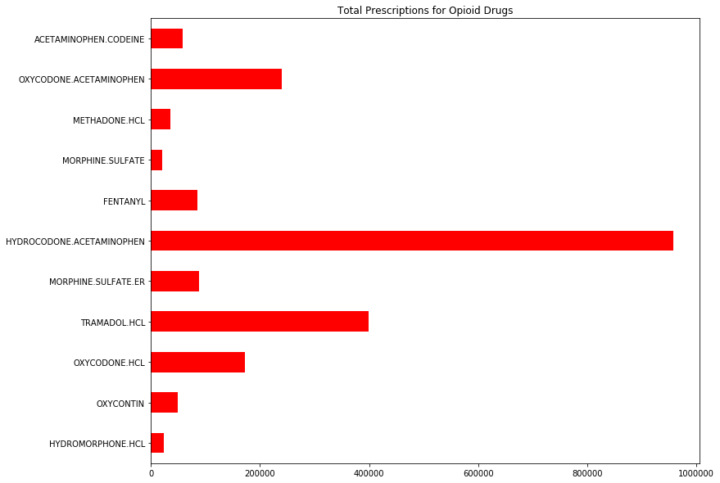
Opioid Prescribed drugs
HYDROCODONE.ACETAMINOPHEN 957439
TRAMADOL.HCL 398734
OXYCODONE.ACETAMINOPHEN 240134
OXYCODONE.HCL 172286
MORPHINE.SULFATE.ER 88190
FENTANYL 85344
ACETAMINOPHEN.CODEINE 58477
OXYCONTIN 49727
METHADONE.HCL 35789
HYDROMORPHONE.HCL 23159
MORPHINE.SULFATE 20707

Slide 19
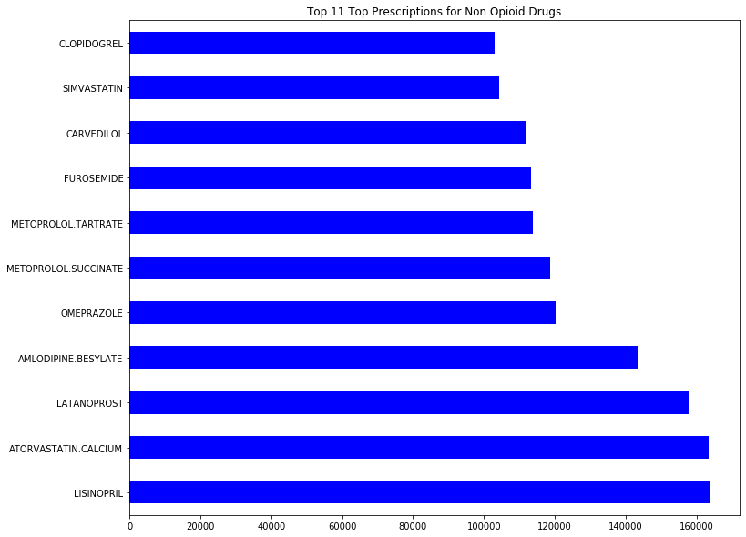
Top 11 non opioid prescribed drugs
LISINOPRIL 163963
ATORVASTATIN.CALCIUM 163367
LATANOPROST 157892
AMLODIPINE.BESYLATE 143293
OMEPRAZOLE 120357
METOPROLOL.SUCCINATE 118610
METOPROLOL.TARTRATE 113758
FUROSEMIDE 113177
CARVEDILOL 111822
SIMVASTATIN 104206
CLOPIDOGREL 102914

Slide 20
Data Visualization Summary
We just wanted to use this previous section to get to know our datasets. For data visualization, it was helpful to start seeing some of the trends that presented themselves as we started grouping certain variables together. We can see a trend in which specialists seem to be prescribing the most drugs in general, as well as which ones seem to be prescribing the most opioid related drugs. Considering that most opioid drugs are based on pain relief, it’s not surprising to see that certain specialists who deal in medical fields that interact with patients coming to them looking for some sort of pain relief, seem to be the common opioid prescribers. As well as prescribers of non opioid pain relief medications.

Slide 21
Statistical
Analysis

Slide 22
Now that we’ve spent some time on data wrangling and creating some visuals to better see what our dataset has, we can dive deeper into the statistical information. Our null hypothesis is that certain specialists are prescribing more opioid drugs.

Slide 23
Frequentism
We will focus on the Total Prescriptions (TotPresc) variable within our dataset.
mean: 137.205864
Std: 3097.55013

Slide 24
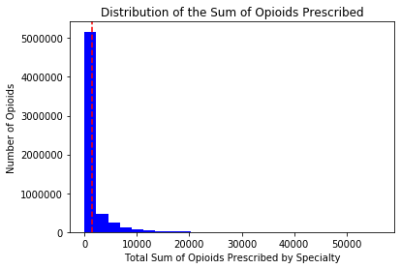
Frequentism
We have a probability value of (0.999) and a critical value of (1.959) and confidence intervals of (1274.135 and 1468.2768)

Slide 25
Creating opioid and non opioid prescribing specialist variables
We separated our specialists from those who prescribed opioid drugs and the specialists who didn’t prescribe any opioid drugs.
opi_presc = prescriber.TotPresc.loc[prescriber['SumOpi'] >= 1]
non_opi_presc = prescriber.TotPresc.loc[prescriber['SumOpi'] == 0]
Results:
Number of Opioids Prescribed: 12688
Number of Specialists who did not prescribe opioids: 12071
Mean of Opioids Prescribed: 2251.877
Standard Deviation of Opioids Prescribed: 4018.83

Slide 26
Calculating t-test
To calculate the t-test, 1st we went with a manual approach by calculating the value of the test statistic and then its probability (the p-value). We also used ttest_ind then verified that we got the same results from both.
T-test: 47.947716278114676
Ttest_ind Result(statistic= 47.94582121833751, pvalue=0.0)
When we set the equal_var to False we got the result:
Ttest_indResult (statistic= 49.00902592890073, pvalue=0.0)
We were able to obtain the same t-test results and noticed a slight change when set to False.

Slide 27
Bootstrapping
We'll create a bootstrap sampling to estimate a 95% confidence interval lower limit.
Null Hypothesis: There isn't a difference in the standard deviation between the 2 groups (specialists prescribing opioids and specialists who didn't prescribe opioids)
Alternate Hypothesis: There will be a differ in the standard deviation between the 2 groups (specialists prescribing opioids and specialists who didn't prescribe opioids)
Difference of STD for opioid and non opioid prescriptions: 3003.2483421030547
Difference of STD for bootstrap samples: 3003.302123387791
The 95% confidence interval for the difference between the standard deviations of opioid and non opioid prescriptions is: [2826.54281741 3187.76267874]

Slide 28
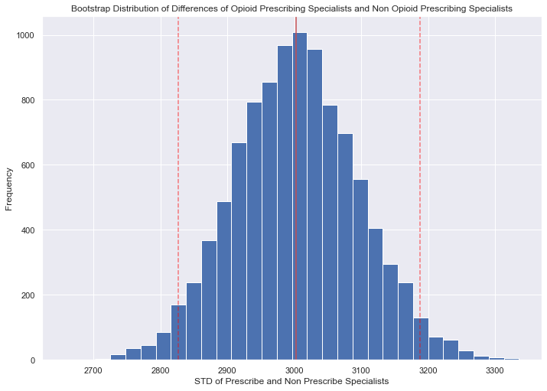
Shows our the Bootstrap replicate with a confidence interval of (2826.542 and 3187.763)

Slide 29
Confidence interval and p-value
We'll perform a bootstrapped hypothesis test at the 5% significance level (α=0.05) to calculate the p-value of the observed difference between opioid prescribing specialist and non-opioid prescribing specialist.
def diff_of_means(data_1, data_2):
diff = np.mean(data_1) - np.mean(data_2)
return diff
# Compute difference of mean insured and uninsured: empirical_diff_means
empirical_diff_means = diff_of_means(opi_presc, non_opi_presc)
# Draw 10,000 permutation replicates: perm_replicates
perm_replicates = draw_perm_reps(opi_presc, non_opi_presc, diff_of_means, size=N_rep)
# Compute permutation p-value: perm_p
perm_p = np.sum(perm_replicates >= empirical_diff_means) / len(perm_replicates)
#Compute p-value: p
p = np.sum(bs_perm_rep >= diff_means)/len(bs_perm_rep)
print('Perm p-value = ', perm_p)
print('P-value= ', p)
Perm p-value = 0.0
P-value= 0.6619

Slide 30
Null hypothesis: There isn't a difference in the mean charges between the 2 groups (specialists prescribing opioids and specialists who didn't prescribe opioids)
Alternate hypothesis: There will be a difference in the mean charges between the 2 groups (specialists prescribing opioids and specialists who didn't prescribe opioids)
With the p-value from the bootstrap being 0.6619, I can reject the alternate hypothesis and accept the null hypothesis

Slide 31
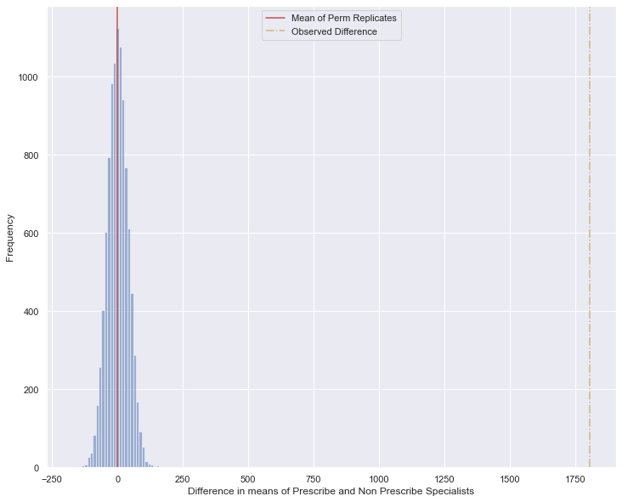

Slide 32
Bayesian Inference
We may suspect from our models that there is some sort of exponential-like distribution at play here. The gamma distribution may be applicable and we could test this for the distribution of prescriptions. Developing our new method for the easiest looking case first is a common and sound approach that can demonstrate a minimum viable solution.

Slide 33
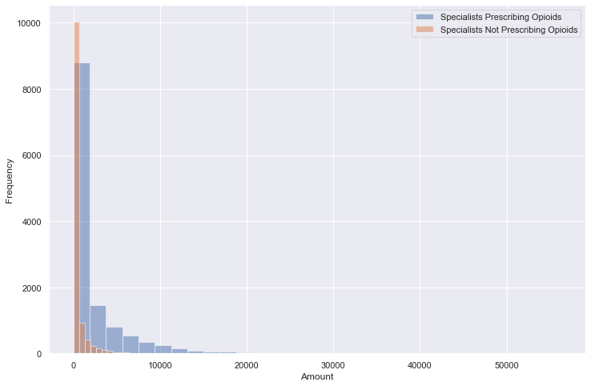
Shows our Specialist who prescribed opioid drugs and non opioids

Slide 34
Creating a PyMC3 Model
with pm.Model() as model:
alpha_ = pm.Exponential('alpha', 1/alpha_est)
rate_ = pm.Exponential('rate', 1/rate_est)
prescribed_opioids = pm.Gamma('Specialists Prescribing Opioids', alpha= alpha_, beta= rate_, observed = opi_presc)
trace= pm.sample(1000, tune=2000, cores=2)
Alpha_chi = [0.40736891 0.42284083]
Rate_ci = [0.00019885 0.00021156]

Slide 35
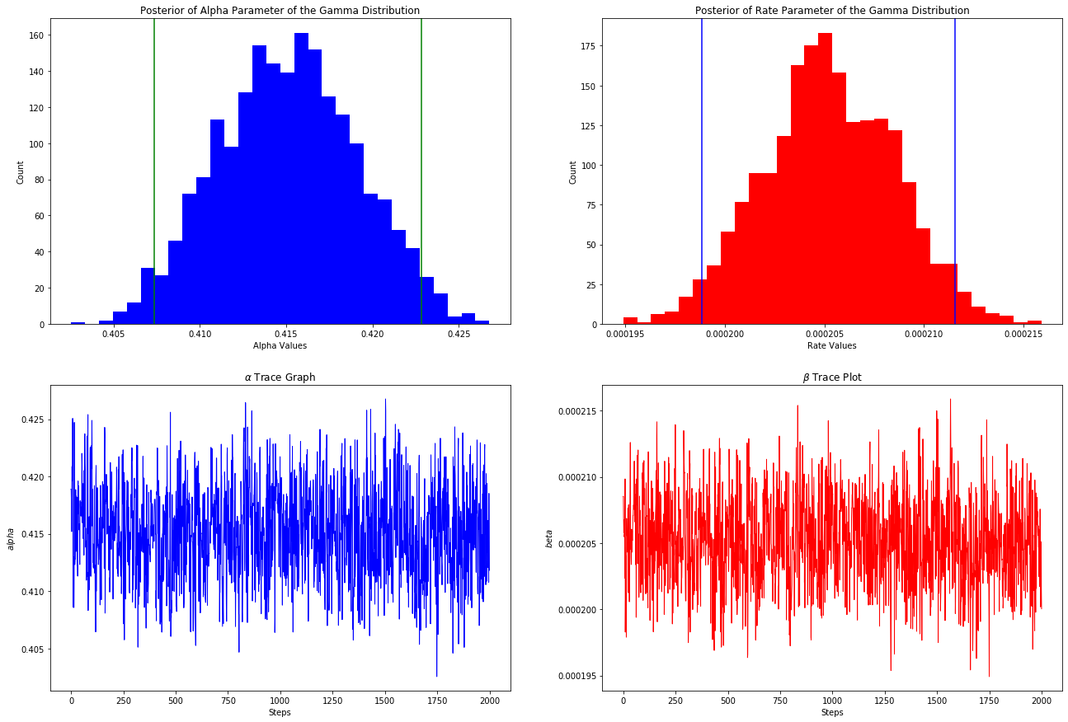
Credible Intervals

Slide 36
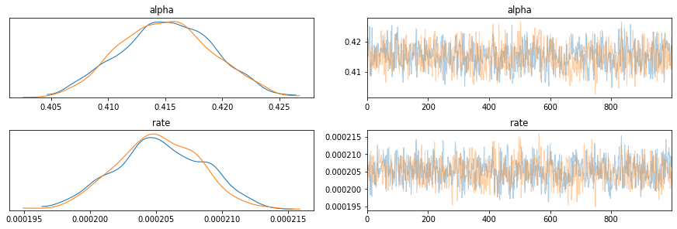
Credible Intervals

Slide 37
We have postulated a distribution to describe the individual amounts for opioid prescriptions cases. This distribution has two required parameters, which we do not know, but we used PyMC3 to perform Bayesian inference to find our level of "belief" in a range of values for them. We then used the average parameter values to create one simulated data set of the same size as the original, but the distribution of our posteriors for these parameters will allow us to perform simulations of any sample size we desire and for a range of scenarios of different a and b.

Slide 38
Model
Optimization

Slide 39
OLS - Ordinary Least Squares
Dep. Variable: | Opioid_Prescriber | R-squared: | 0.338
Model: | OLS | Adj. R-squared: | 0.334
Method: | Least Squares | F-statistic: | 79.92
Date: | Mon, 04 May 2020 | Prob (F-statistic): | 0.00
Time: | 10:00:16 | Log-Likelihood: | -12485.
No. Observations: | 24759 | AIC: | 2.529e+04
Df Residuals: | 24601 | BIC: | 2.657e+04
Df Model: | 157
Covariance Type: | nonrobust
coef | std err | t | P>|t| | [0.025 | 0.975]
Intercept | 0.5862 | 0.241 | 2.432 | 0.015 | 0.114 | 1.059

Slide 40
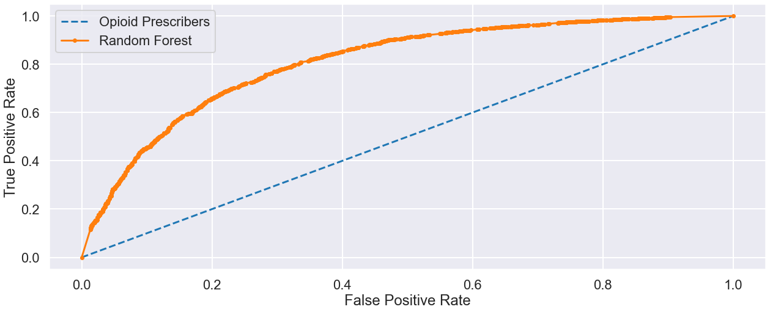
ROC-AUC-curve
ROC AUC = 0.809

Slide 41
Baseline Test (default parameters)
Model | Class | Precision | Recall | F1-score | Support | Accuracy
Random Forest Classifier | 0 (prescriptions) | 0.68 | 0.70 | 0.69 | 3084 | 0.74
 | 1 (10 or more opioid prescriptions) | 0.79 | 0.77 | 0.78 | 4344
macro avg 0.73 0.74 0.74 7428
weighted avg 0.74 0.74 0.74 7428

Slide 42
Importance Feature
Our Random Forest model produces a lesser accuracy than our OLS model with a R-squared: 0.273. We are also able to check feature importance with a model from the random forest model. In regards to Specialists we can see that Family Practice, Emergency Medicine, Internal Medicine and Orthopedic Surgery specialists are the highest. Along with Population.
 | Feature | importance | rank
74 | Specialty_Family Practice | 0.106276 | 1
0 | Population | 0.070633 | 2
71 | Specialty_Emergency Medicine | 0.066525 | 3
91 | Specialty_Internal Medicine | 0.063420 | 4
119 | Specialty_Orthopedic Surgery | 0.048439 | 5

Slide 43
XGBoost
XGBRegressor(base_score=0.5, booster=None, colsample_bylevel=1,
colsample_bynode=1, colsample_bytree=1, gamma=0, gpu_id=-1,
importance_type='gain', interaction_constraints=None,
learning_rate=0.05, max_delta_step=0, max_depth=3,
min_child_weight=1, missing=nan, monotone_constraints=None,
n_estimators=100, n_jobs=0, num_parallel_tree=1,
objective='reg:squarederror', random_state=0, reg_alpha=0,
reg_lambda=1, scale_pos_weight=1, subsample=1, tree_method=None,
validate_parameters=False, verbosity=None)
Hyperparameter tuning

Slide 44
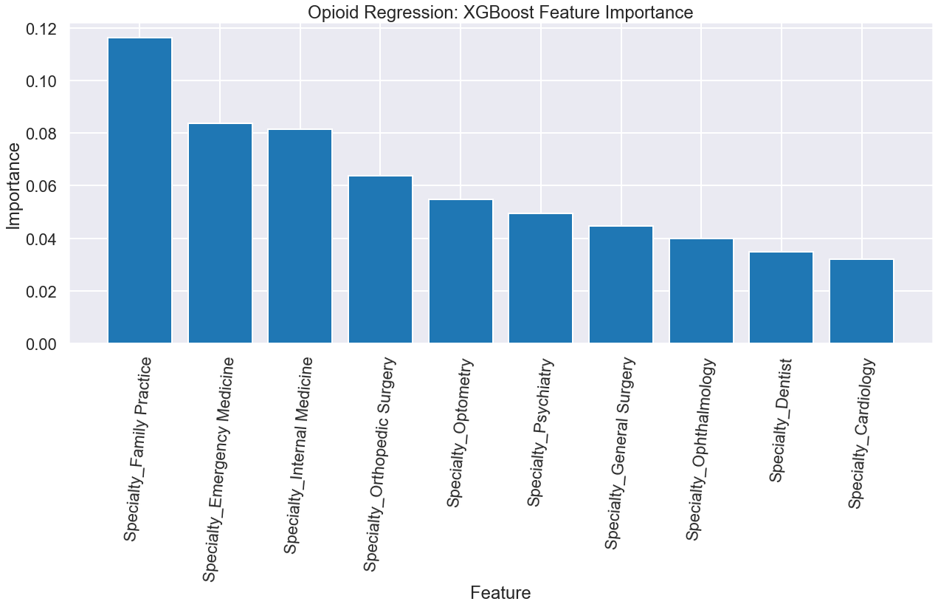
XGBoost Feature Importance

Slide 45
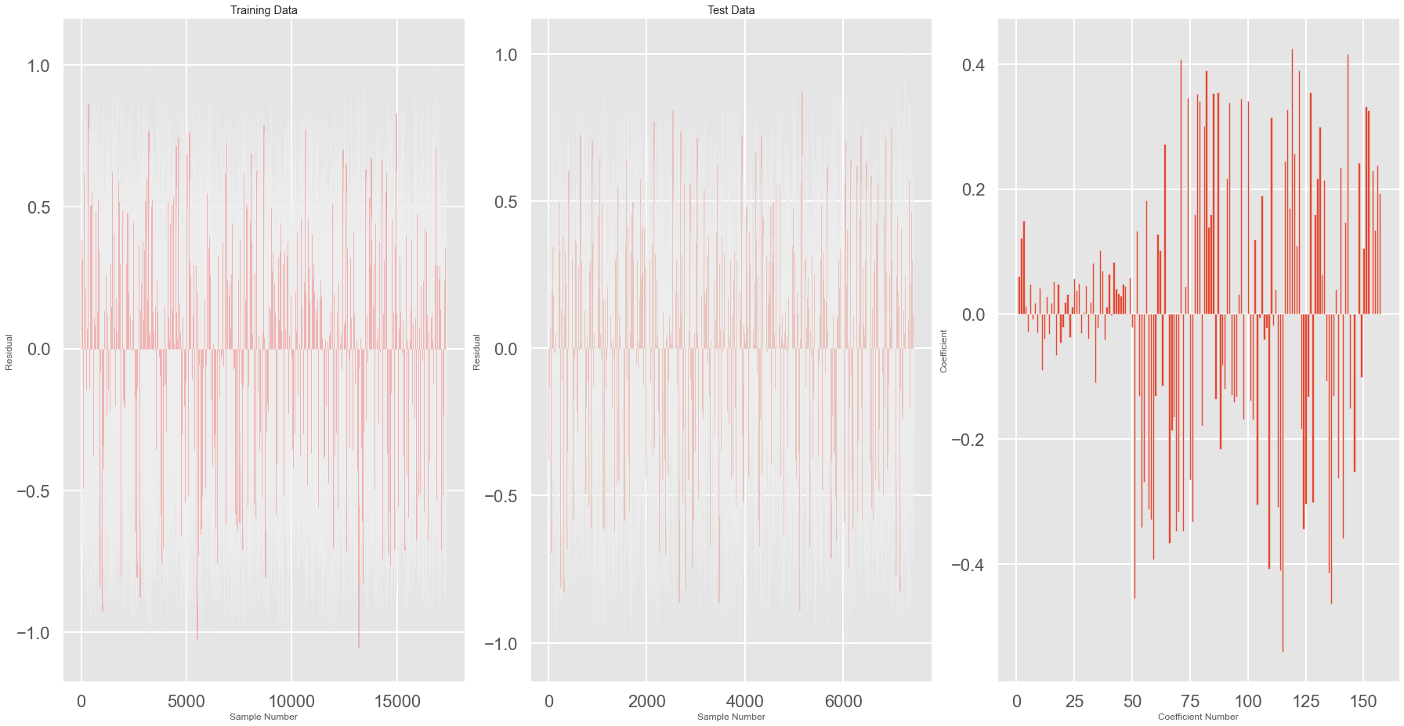
Ridge
Model score: 0.32746150164605226

Slide 46
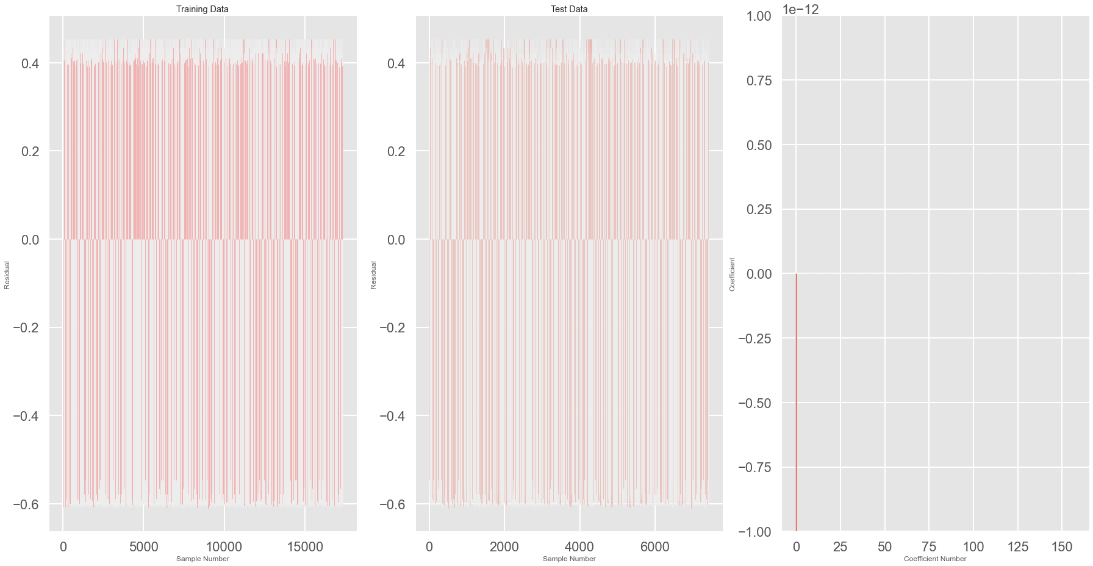
Lasso
Model score: 0.001645085001821811

Slide 47

ElasticNet
Model score: 0.001644726081960757

Slide 48
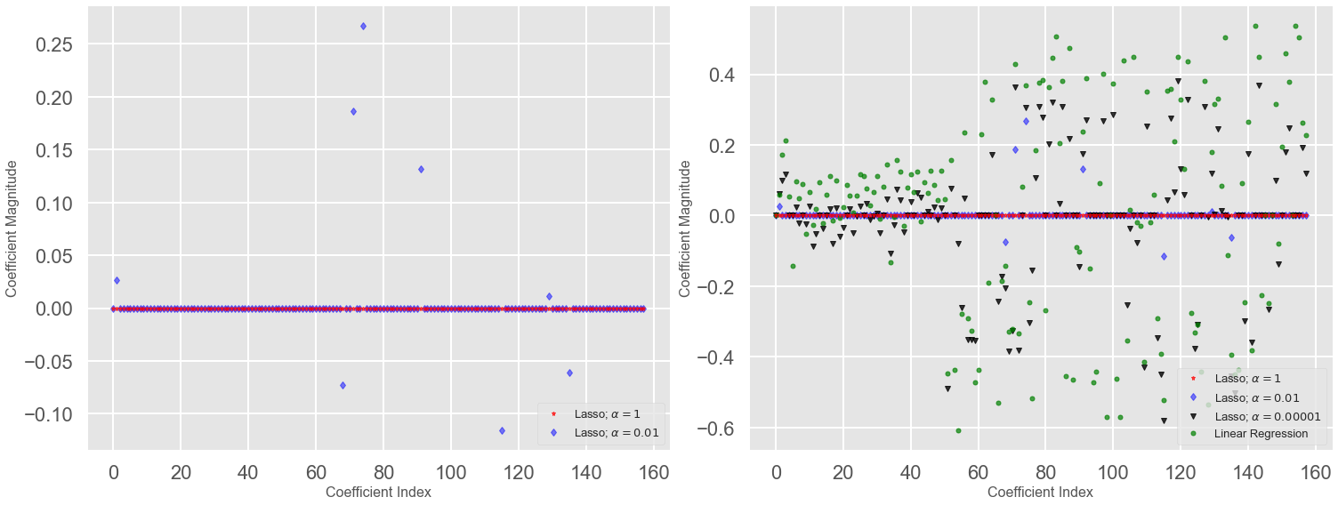
training score: 0.0013795676148582459
test score: 0.001645085001821811
number of features used: 1
training score for alpha=0.01: 0.120829512815265
test score for alpha =0.01: 0.11701618597179997
number of features used: for alpha =0.01: 9
training score for alpha=0.0001: 0.33567482501633106
test score for alpha =0.0001: 0.32581576633729326
number of features used: for alpha =0.0001: 107
LR training score: 0.3399635543912346
LR test score: 0.3259130150261611

Slide 49
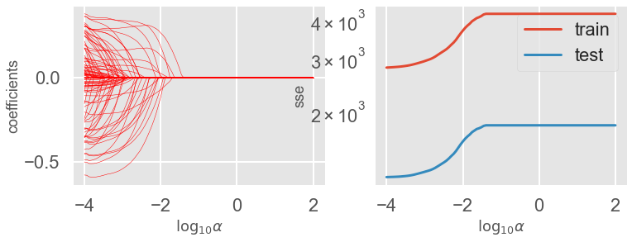
The coefficients and the sum of squared errors (SSEs) for the training and testing datasets for Lasso regression as a function of the logarithm of the regularization strength parameter. On the left panel we see a large number of coefficients are nonzero. We also see that when alpha is increase many of the coefficients collapse to zero. On the right side we see that SSE of both training and testing rise gradually.

Slide 50
Comparing Models
Of these models, none of them scored as high as we would have liked. Our Linear Regression and Ridge models scored the highest but to fully utilize we need to better fit them to prevent overfitting and hopefully raise the scores.
name | r-square
Linear Reg | 0.325913
Ridge | 0.327462
Lasso | 0.001645
ElasticNet | 0.001645

Slide 51
Summary

Slide 52
Comparing Models
None of our models were especially impressive. XGBoost is our highest but overall, our models don't really give us an impressive score. To better the score we'd need to add more features. These models tried to predict if a specialist would prescribe an opioid to their patients. We certainly saw some of the variables that seems to saw a strong connection to opioid prescriptions. in regards to specialists, the type of specialists who had the highest scores were based around environments in which their patients would be in some sort of physical pain.
Name | r-squared
OLS Regression | 0.337779
Random Forest | 0.272954
XGBoost | 0.247265
Lasso | 0.001645

Slide 53
Summary
Results
Results:
Our models did not score as high as we would have liked but we were able to see some benefits from them
Type of specialists and location did seem to show that they were a factor within the members of our dataset who were prescribing opioids.
More tuning and reworking with the categorical variables will be needed to better tune the models.
Future direction:
Further modeling and hyperparameter tuning should be done such as a running a gridsearch or random search with the final random forest classifier model.
Additional data would be needed to better improve the model

